Slide 1

Swansea Schools Stand up for Ukraine
Thursday 10th March 2022

Slide 2
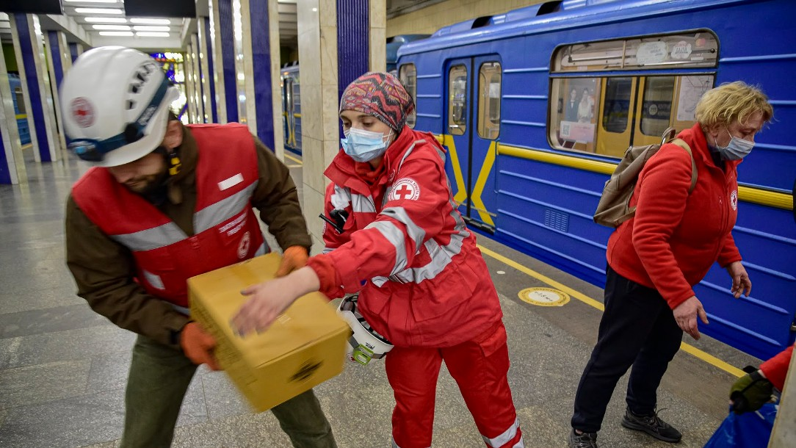
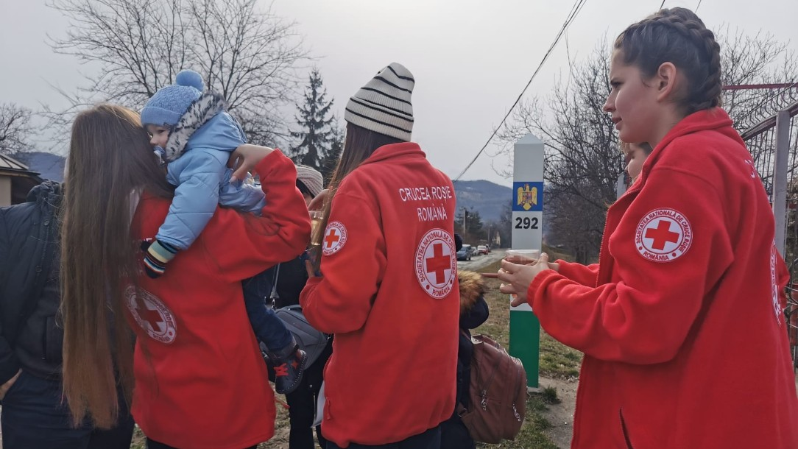
What is the Red Cross doing to help Ukrainian people now?
So far, Red Cross teams in Ukraine have distributed over 30,000 food and hygiene parcels and provided food, warm clothes, and other aid to around 8,000 people sheltering in metro stations.
First aid training has also been delivered to over 2,000 people taking cover in metro stations and bomb shelters, so they have the skills to treat their loved ones if needed.

Slide 3

What’s happening right now

Slide 4
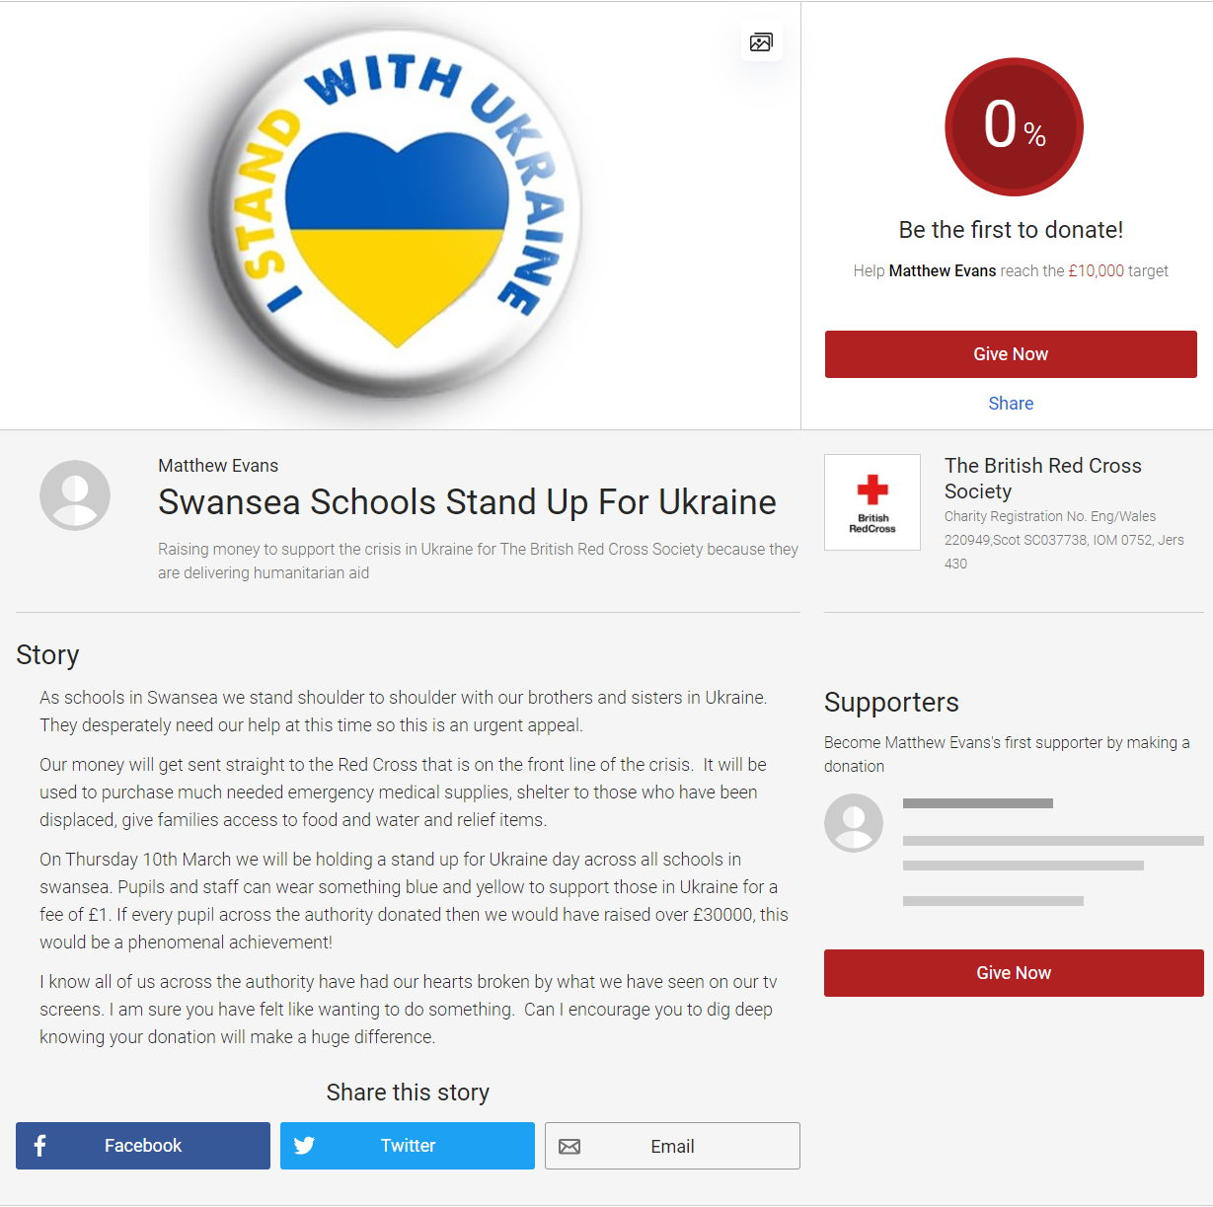
What are Swansea schools doing?
Our money will get sent straight to the Red Cross that is on the front line of the crisis. It will be used to purchase much needed emergency medical supplies, shelter to those who have been displaced, give families access to food and water and relief items.
On Thursday 10th March we will be holding a ‘Stand up for Ukraine’ day across all schools in Swansea.
Pupils and staff can wear something blue and yellow to support those in Ukraine for a fee of £1.

Slide 5
Your donations matter!
Your donation will help us reach more people.
  £10 could provide a hygiene kit to a family of five, giving them supplies to stay healthy for a month
  £20 could provide five blankets to families taking shelter
  £33 could provide 40 chlorine tablets to ensure that families have access to clean, safe water
  £72 could provide a thermometer to help treat those who have fallen ill
  £210 could provide a fully equipped first aid kit, including supplies, to a first aider treating those wounded

